Slide 1
Makefile reference
Information and examples about using makefiles with C++

Slide 2
What is a makefile?
A makefile is an extensionless file that has a series of commands for a computer to execute.
In our case, it is a script that compiles your program with one short command (compared to a long compilation command.
It allows your program to be compiled into an executable with one short command: “make all”.

Slide 3
Why do we use makefiles?
The specific commands used to compile a program can vary depending on the computer and compiler.
It is easier to remember one command than to remember a lot of different ones.
“make all” is much simpler to use than “g++-7.2.0 –std=c++11 file.cpp main.cpp”

Slide 4
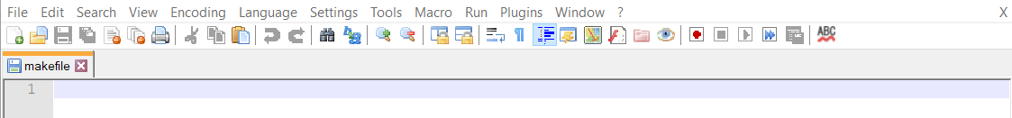
How can I make a makefile? Pt. 1 – Setting up the file
Create a text file called “makefile”
This file should be in the same directory as your source files
Delete the “.txt” extension from the file
You can still use Notepad/Notepad++ or another text editor to edit.
Open up the file in a text editor (I use Notepad++)

Slide 5

How can I make a makefile? Pt. 2 – Command structure
Let’s say you have three total files: class.h, class.cpp, and main.cpp
First, the makefile needs a structure that tells it what goes where.
Generally, this is done by typing the name of some output, followed by a series of files that go into the output
Temporary files (usually .o files) are created to hold the results of a partial compilation
Ultimately, these temporary files are compiled together to produce the final executable
For example, have two .o output files to hold temporary compilation results: Class.o and Main.o
Class.o will hold our class’s files, class.h and class.cpp
Main.o will hold the testing file, main.cpp along with class.h
Class.o and Main.o should be combined with the “all” heading
End Result

Slide 6





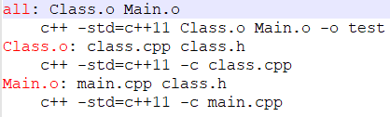
How can I make a makefile? Pt. 3 – Adding commands
With the output files specified, it’s time to add the actual commands
The actual commands should have a tab indent on a new line
For each output file, a different compilation command should be specified.
Main.o: OR
Class.o: OR
all: OR
The end result is two temporary files (Main.o and Class.o) and a final executable called “test”.
End Result

Slide 7

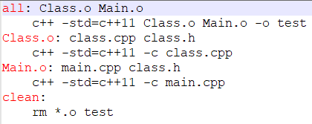
How can I make a makefile? Pt. 4 – Cleanup
Lastly, good makefiles also have a removal command to clean up the executable and any temporary files.
This is usually put at the end under a “clean” section
In UNIX, the command for removing files is “rm [insert file here]”
In our makefile, it looks like this:
To use this command, type “make clean” instead of “make all”
Our makefile is now complete! We can now type “make all” to create an executable called “test”, which we can then run. If we don’t want the executable anymore, we type “make clean” to remove it and the .o temporary files.
End Result

Slide 8



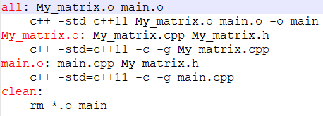
Example Progression
As an example, say I have a program with three files: My_matrix.cpp, My_matrix.h, and main.cpp
I want two temporary files: My_matrix.o and main.o along with the executable, called “main”
My_matrix.o would look like this:
main.o would look like this:
“all” would look like this:
“clean” would look like this:
Final makefile

Slide 9



Example Progression Cont.
If we run our makefile in the terminal, this is the output
Before running “make all”:
Running “make all”:
After running “make all”:
Running “make clean”:
After running “make clean”:

Slide 10
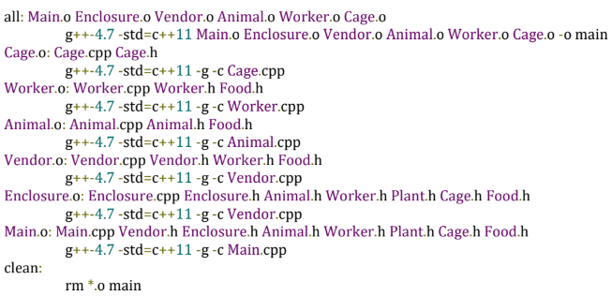
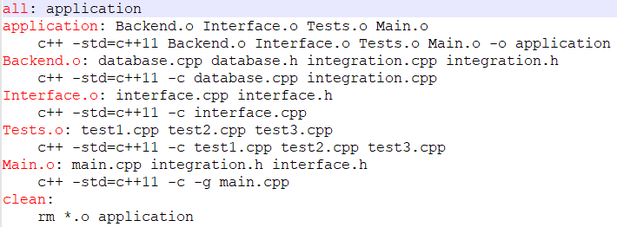
Additional Examples
A large program’s makefile
This makefile produces an executable called “main”
Another large program’s makefile
This makefile produces an executable called “application”

Slide 11
Thanks for reading!
If you have any additional questions, feel free to contact your professor, TAs, or PTs by talking to them in class/lab, over email, or through Piazza

